Slide 1
The Nickels and Dimes of Education for All
Part II: Will we (ever) reach universal primary completion, and how much will it cost?
Carina Omoeva and Ania Chaluda
Education Policy and Data Center, FHI 360
epdc@fhi360.org

Slide 2
What does it mean to reach universal completion?
entering school
staying in school
learning

Slide 3
Research questions
Is universal completion within reach?
What are the cost implications of reaching this goal?

Slide 4
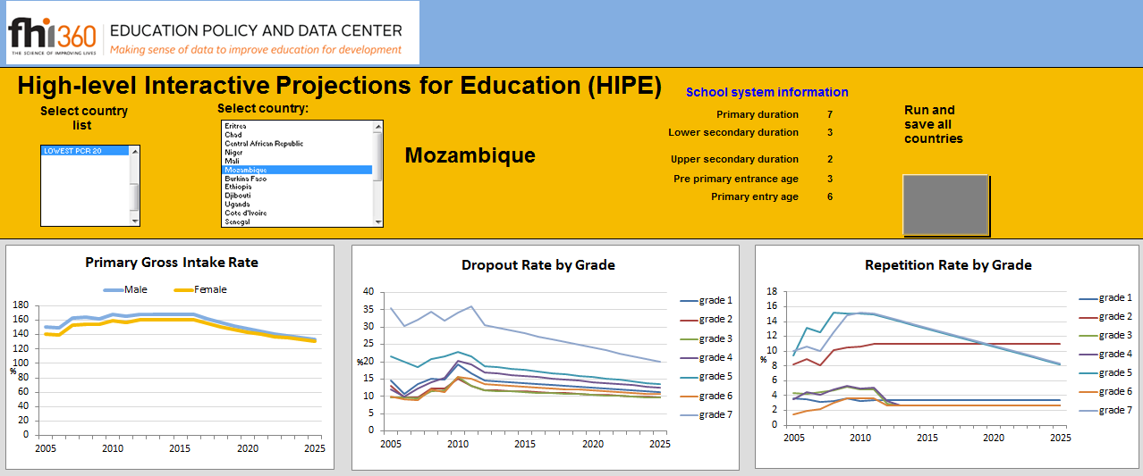
HIPE: the EPDC model for trend-based projections
Assumptions in the Basic (Progressive) Scenario:
GROSS INTAKE RATE:
If higher than 100%, it stays constant for 5 years and then decreases gradually to 100%; if lower than 100%, it increases gradually to reach 119% (males) and 114% (females), then gradually decreases.
DROPOUT RATE:
Set to decrease to a minimum of 2%; the higher the rate, the steeper the decrease.
REPETITION RATE:
Set to decrease to a minimum of 1.3-3% depending on grade and gender, the higher the rate, the steeper the decrease.

Slide 5
Is universal primary completion within reach?
Basic Scenario: Primary School Completion Rates

Slide 6
Is universal primary completion within reach?
Basic Scenario: Primary School Completion Rates in Low Income Countries
Notes:
Talk about Eritrea and Uganda

Slide 7
What is “universal primary completion”?
number of non-repeating students in the last grade of primary school
Primary School Completion Rate =
population of the last grade of primary school age

Slide 8
What is “universal primary completion”?
number of non-repeating children in the last grade of primary who are no more than 2 years older than the expected age for this grade
On time completion =
population of the last grade of primary school age
Survival = percentage of children who are in the first grade of primary school who are expected to reach a certain grade, regardless of repetition

Slide 9
Do students learn more when they repeat?
Research shows that….
Repetition does not increase learning. Repeating students don’t usually progress more than they would have had they been promoted (Verspoor et al, 2005)
Repetition increases the risk of dropping out (Majgaard & Mingat, 2005; Wechtler et al, 2005)
Automatic promotion? Not necessarily, but reducing some very high repetition rates observed in certain developing countries should be considered.
Notes:
citations

Slide 10
Can we accelerate the progress?
Accelerated Progress I
Accelerated Progress II
No dropout
If GIR < 100%, it is set to reach 100% by 2015
No dropout
If GIR < 100%, it is set to reach 100% by 2015
No repetition

Slide 11
Can we accelerate the progress?

Slide 12
Can we accelerate the progress?

Slide 13
Can we accelerate the progress?

Slide 14
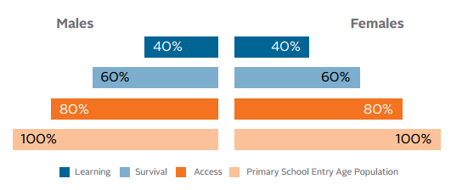
What about learning?
Learning Pyramid

Slide 15
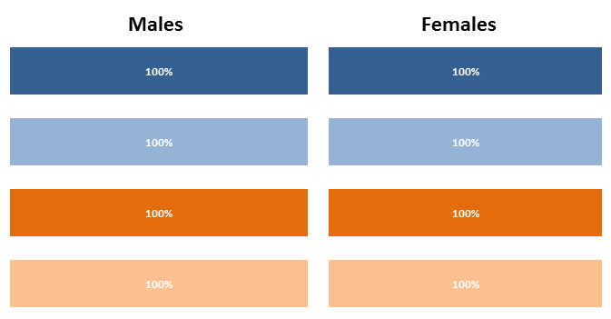
Components of the Learning Pyramid
An ideal school system:
ACCESS: % of 14 year olds who have ever entered school
SURVIVAL: % of grade 1 students who reach the given grade in which assessment test was administered
LEARNING: % of students reached the low level of learning according to SACMEQ, PIRLS, SERCE and PASEC

Slide 16
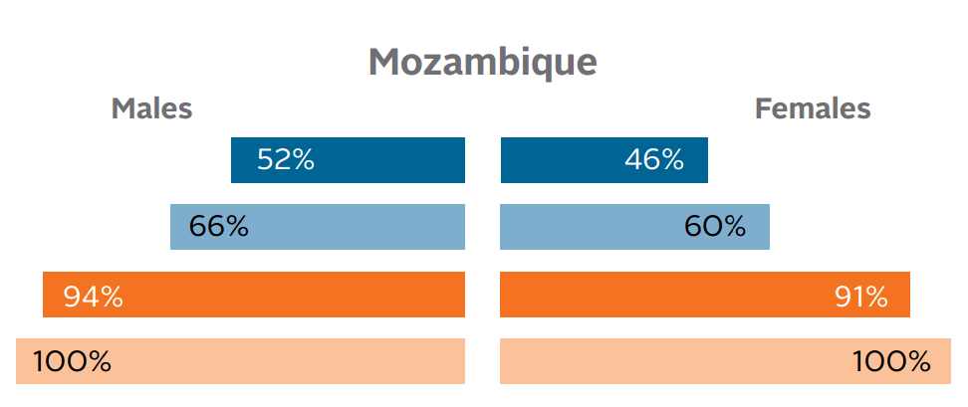
Results

Slide 17
What are the cost implications?

Slide 18
Calculating the cost of increased enrollment
Projected Budget
Projected Expenditure
FINANCE GAP
…or SURPLUS
Budget projections:
government spending on primary education is kept at a constant percentage of GDP
GDP projections are taken from the IMF World Economic Outlook
Expenditures projections:
Per pupil expenditure is adjusted for inflation and multiplied by projected enrollment

Slide 19
Calculating the cost of increased enrollment
3 scenarios:
Basic
Cost Premium
Accelerated Progress I
Trend-based “progressive” scenario and per pupil expenditure adjusted for inflation
Basic scenario + 30% of additional cost for new pupils
No dropout and if GIR < 100%, it is set to increase to 100% by 2015 + 30% of additional cost for new pupils

Slide 20
Calculating the cost of increased enrollment
Projected Budget
Projected Expenditure
FINANCE GAP
…or SURPLUS
Budget projections:
government spending on primary education is kept at a constant percentage of GDP
GDP projections are taken from the IMF World Economic Outlook
2014 | 2015 | 2016 | 2017 | 2018 | Cumulative 2014-2018
9 | 9 | 8 | 8 | 8 | 37
Projected % increase in GDP in Mozambique:
Expenditures projections:
Per pupil expenditure is adjusted for inflation and multiplied by projected enrollment
Per primary pupil expenditure in Mozambique: $54 (2006)

Slide 21
The finance gap/surplus

Slide 22
Calculating the cost of increased enrollment
4 scenarios:
Basic
Cost Premium
Accelerated Progress I
Accelerated Progress II
Trend-based “progressive” scenario and per pupil expenditure adjusted for inflation
Basic scenario + 30% of additional cost for new pupils
No dropout and if GIR < 100%, it is set to increase to 100% by 2015 + 30% of additional cost for new pupils
Accelerated Progress I + no repetition

Slide 23
The finance gap/surplus

Slide 24
The finance gap/surplus

Slide 25
The cost of repetition
 | Scenario 1 |  | Scenario 2
Rate in each grade of primary school | 10% |  | 20%
Number of children entering grade 1 | 1,000,000 |  | 1,000,000
Survival to grade 5 | 100% |  | 100%
Number of students reaching grade 5 within 10 years | 999,936 |  | 996,934
Per pupil expenditure per year ($) | $100 |  | $100
Cost of educating these students ($Millions) | $544 |  | $597
Cost of Educating These Students without REPETITION ($ Million) | $500 |  | $498
DIFFERENCE ($ Millions) | $44 |  | $98

Slide 26
Calculating the cost of increased enrollment
5 scenarios:
Basic
Cost Premium
Accelerated Progress I
Accelerated Progress II
Learning
Trend-based “progressive” scenario and per pupil expenditure adjusted for inflation
Basic scenario + 30% of additional cost for new pupils
No dropout and if GIR < 100%, it is set to increase to 100% by 2015 + 30% of additional cost for new pupils
Accelerated Progress I + no repetition
Basic scenario + learning premium:
if 50% of students have basic reading skills, it is assumed that the current level of spending educates only 50% of students and in order to educate all students, expenditure needs to be doubled.

Slide 27
The finance gap/surplus

Slide 28
The finance gap/surplus

Slide 29
Does more $ really increase learning?
Not necessarily.
Studies show that “more of the same” does not lead to increased levels of student achievement (J-PAL, http://www.povertyactionlab.org). Countries that spend more do not always produce better learning outcomes.
Resources are necessary but they do not guarantee improved learning.

Slide 30
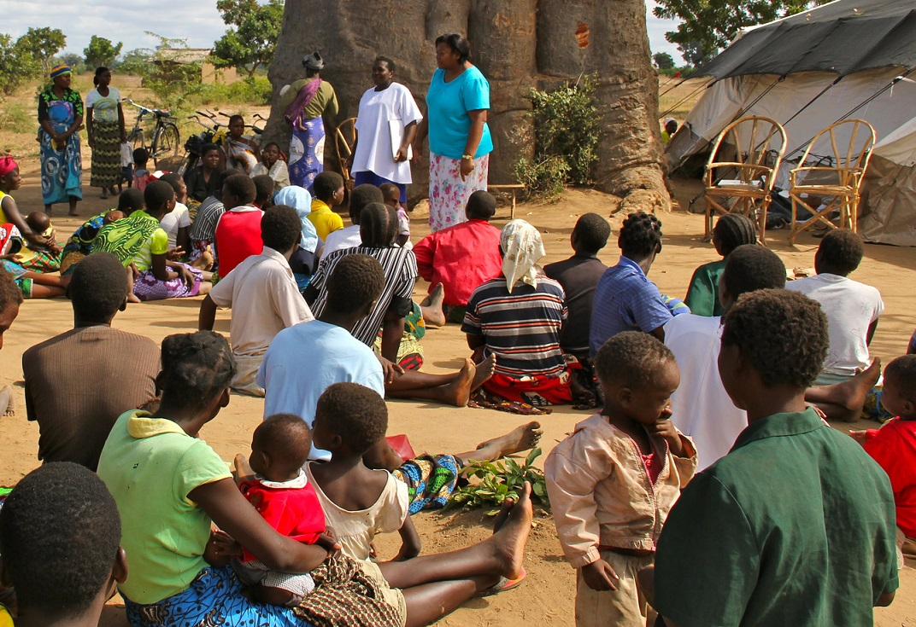
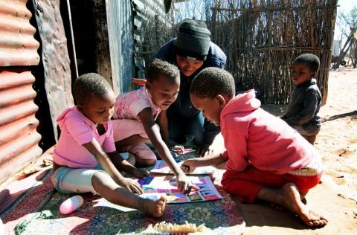
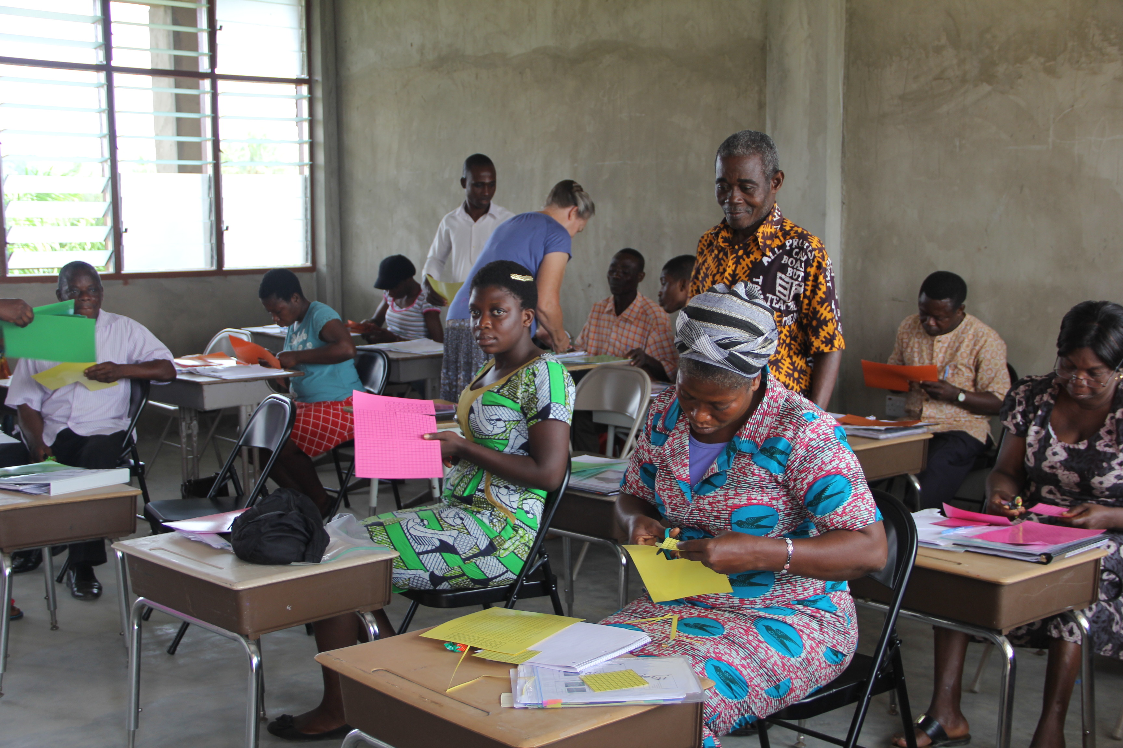
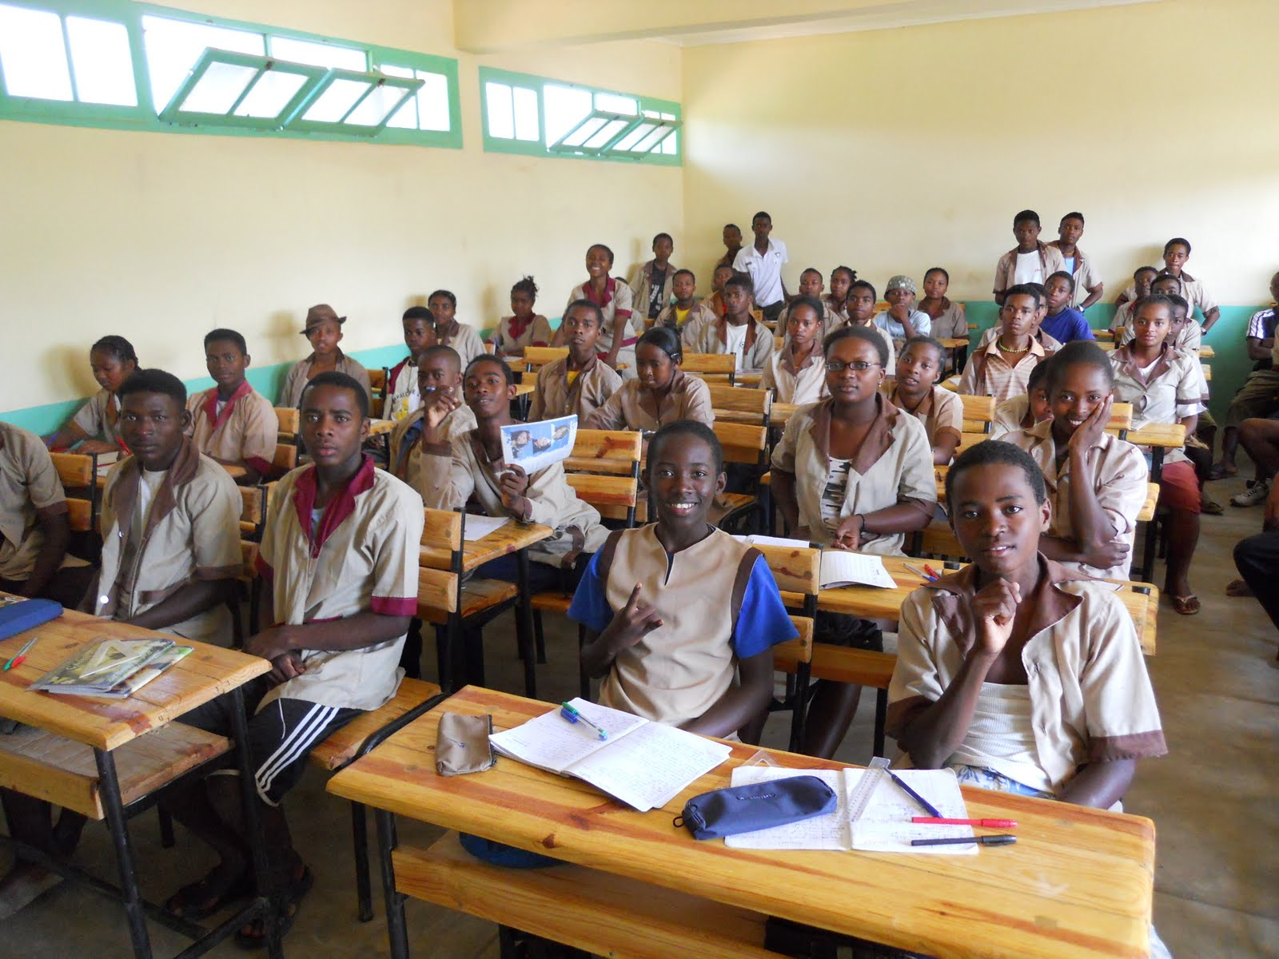
Does more $ really increase learning?
community involvement and increased school accountability
remedial education
textbooks
hiring extra teachers on short-term contracts
short-term in-service training focusing on improving instruction
class size reduction for classes over 60 pupils

Slide 31
Does more $ really increase learning?
Randomized evaluations don’t always confirm findings that come out of retrospective studies (Kremer, 2003).
The main challenge: controlling for a number of hard to measure variables, such as student innate ability and motivation, teacher quality, or parents’ preference for child attending school (Glewwe & Kremer, 2005)

Slide 32
Conclusions
Many countries are still far from reaching universal primary completion and approaching this goal even by 2020 would require unrealistic reductions in dropout and repetition
Getting children to school may be financially plausible in many developing countries but ensuring sufficient resources to enable learning will be a big challenge
Simply adding more resources does not increase learning – it is most important how these resources are transformed into effective policy interventions
Measuring student learning and continuously evaluating various approaches is essential to developing cost efficient ways to increase the quality of education

Slide 33
Thank you
Please visit us at www.epdc.org for more information.

